Slide 1

Mohit Gangwani
Data Scientist
datais.life

Slide 2
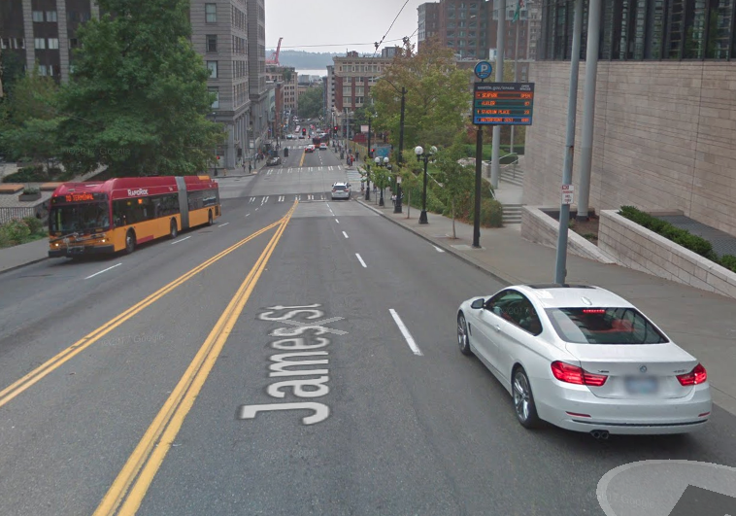
Purpose
Challenging move to a new city
Different apps for everything
Elevation not properly considered
Apps don’t personalize solutions
Missing information

Slide 3
Process
Identified Problem
04
01
03
02

Slide 4
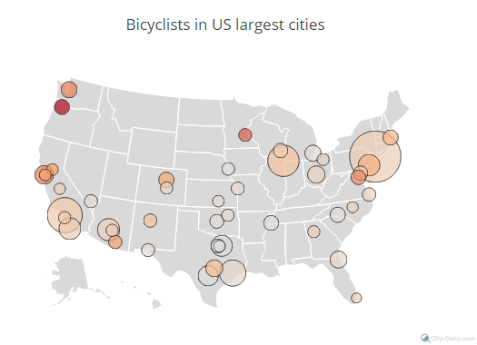
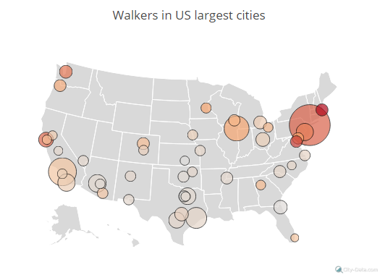
Most Walking and Biking Populations

Slide 5

People are Walking more

Slide 6

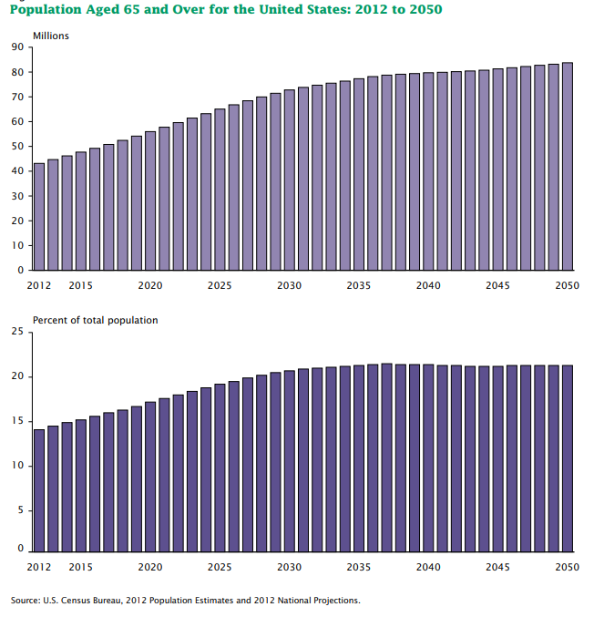
Disabled and Elderly Population

Slide 7
Solution
Rise Over Run
RiseOverRun.io
Web App
Solves many problems
Layers to help you find only relevant places
Custom routes for you

Slide 8
Process
Identified Problem
04
01
03
Testing Different Services
02

Slide 9



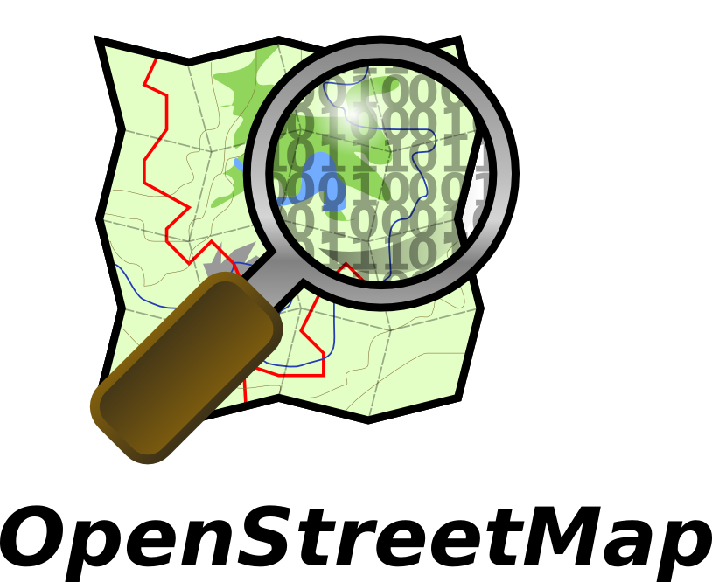

Tools
Linear Model:
Python
Round 1
Quantum GIS
Geopy
USGS
Round 2
Open Layers
Leaflet.js
OSM
Overpass API
Open Elevation

Slide 10
Process
Identified Problem
04
01
03
Testing Different Services
Routing Algorithm + Running Linear Model on walking data
02

Slide 11
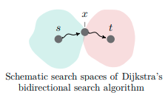
Routing Algorithms
Dijkstra* Bidirectional Algorithm
Added weights
Cost Matrix
Lowest Cost Route

Slide 12
Process
Putting it all together and deploying
Identified Problem
04
01
03
Testing Different Services
Routing Algorithm + Running Linear Model on walking data
02

Slide 13




Future
User Database
App for iOS & Android
Latent Model for every user
Extra Features

Slide 14
Any Questions?

Slide 15




Mohit Gangwani
Data Scientist
in/MohitGangwani
Data-is-Life
RiseOverRun.io
MohitGangwani@Outlook.com

